Slide 1
Introduction
Paper Name: Formal languages and Automata Theory
Paper Code: PCCCS502
Paper Credit: 3
Lecture - 1

Slide 2

Introduction of Theoretical Computer Science
.

Slide 3
Introduction of Theoretical Computer Science
Mathematicians one the war mathematicians broke the Japanese codes and build a now mathematicians like you ﻿this the goal that the soviets is global community in medicine or economics in technology or space battle lines of being wrong two triumph we need results help punishable applicable result is now who among you will be the next Moore's for the next Einstein who among you will be the vanguard of democracy freedom and discovery today we been ways America's future into your people hands welcome to Princeton gentlemen

Slide 4
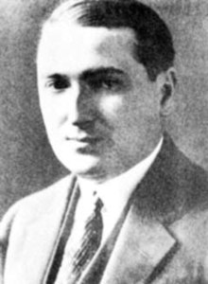
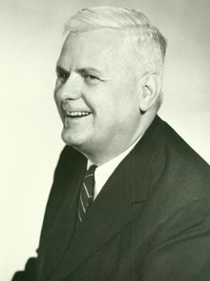
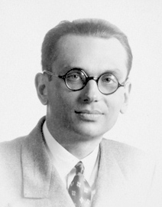
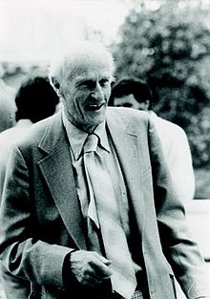
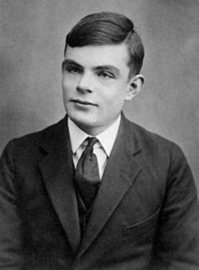
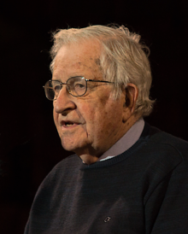
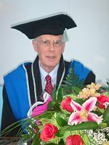
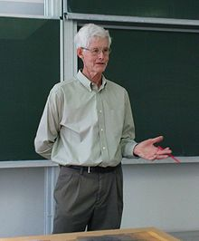
Mathematicians
Emil Leon Post Alonzo Church Kurt Gödel Stephen Cole Kleene
Alan Turing Noam Chomsky John Hopcroft Stephen Cook

Slide 5
Emil Leon Post
Computability theory: computability theory, also known as recursion theory, is a branch of mathematical logic, computer science, and the theory of computation that originated in the 1930s with the study of computable functions and turing degrees. The field has since expanded to include the study of generalized computability and definability. In these areas, recursion theory overlaps with proof theory and effective descriptive set theory.

Slide 6
Alonzo Church
Contributions to mathematical logic and the foundations of theoretical computer science. He is best known for the Church–Turing thesis.
Mathematical logic is often divided into the fields of set theory, model theory, recursion theory, and proof theory.
It states that a function on the natural numbers can be calculated by an effective method if and only if it is computable by a Turing machine.

Slide 7
Kurt Gödel
Gödel developed a technique now known as Gödel numbering, which codes formal expressions as natural numbers.
In mathematical logic, a Gödel numbering is a function that assigns to each symbol and well-formed formula of some formal language a unique natural number, called its Gödel number.
A Gödel numbering can be interpreted as an encoding in which a number is assigned to each symbol of a mathematical notation, after which a sequence of natural numbers can then represent a sequence of symbols.
In mathematical logic, propositional logic and predicate logic, a well-formed formula, abbreviated WFF or wff, often simply formula, is a finite sequence of symbols from a given alphabet that is part of a formal language.

Slide 8
Stephen Cole Kleene
He was an American mathematician.
He helped to provide the foundations of theoretical computer science.
A number of mathematical concepts are named after him: such as the Kleene star (Kleene closure).

Slide 9
Alan Turing
Turing was highly influential in the development of theoretical computer science, providing a formalisation of the concepts of algorithm and computation with the Turing machine, which can be considered a model of a general-purpose computer.

Slide 10
Noam Chomsky
Avram Noam Chomsky is an American linguist, philosopher, cognitive scientist, historian, social critic, and political activist.
He created or co-created the universal grammar theory, the generative grammar theory, the Chomsky hierarchy.

Slide 11
John Hopcroft
John Edward Hopcroft is an American theoretical computer scientist. His textbooks on theory of computation and data structures are regarded as standards in their fields.

Slide 12
Stephen Cook
Stephen Arthur Cook is an American-Canadian computer scientist and mathematician who has made major contributions to the fields of complexity theory and proof complexity.
Computational complexity theory focuses on classifying computational problems according to their resource usage, and relating these classes to each other. A computational problem is a task solved by a computer. A computation problem is solvable by mechanical application of mathematical steps, such as an algorithm.
Proof complexity is the field aiming to understand and analyse the computational resources that are required to prove or refute statements.

Slide 13
Introduction of Theoretical Computer Science
Theoretical computer science (TCS) is a subset of general computer science and mathematics that focuses on more mathematical topics of computing and includes the theory of computation.

Slide 14
Contd..
TCS covers a wide variety of topics including:
Algorithms,
Data structures,
Computational complexity,
Parallel and distributed computation,
Probabilistic computation,
Quantum computation,
Automata theory,
Information theory,
Cryptography,
Program semantics and verification,
Machine learning,
Computational biology,
Computational economics,
Computational geometry, and
Computational number theory and algebra.

Slide 15
Introduction of Theory of Computation
When we write an algorithm take a problem and we try to find out how much time or space that algorithm is taking to solve an input, i.e. The time complexity and space complexity of the algorithm.
But in TOC we focus on what is the limitation of a problem. What kind of problem can not be solved even by a computer?

Slide 16
Contd..
TOC deals with what is the limitation of a problem means no digital computer is going to solve a problem.
TOC is a study of mathematical machines called automata.
Example: Finite Automata, PDA, Turing Machine these are different kinds of Machines.

Slide 17
Contd..
Why there are many machines like FA,PDA or TM?
Because question is not only to solve a machine but to solve it in minimum time and less effort.
So, the main objective of automata are as follows:
Whether a problem is solvable or unsolvable?
If solvable then how efficiently we solve it.

Slide 18
Turing Machine
Among many more automata or theoretical machines Turing Machine (TM) is the most powerful and strongest.
It can be assume as a hypothetical digital computer.
If a problem is solvable using TM then it can also be solvable using modern digital computer.

Slide 19
Historical Information
Alan Mathison Turing (1912-1954)

Slide 20
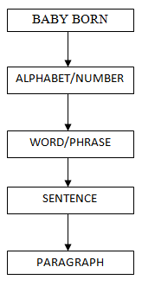
Theory of formal Language (TOFL)

Slide 21
Theory of formal Language (TOFL)
Human and human or m/c and human needs communication.
When two person communicate we use Natural Language (NL). It is very complex because it includes facial expression, hands and body movement, emotions, voice modulation etc.
But when one human and a machine communicate then m/c do not require to understand the human emotions. So, human and machine needs formal language (FL) to communicate.

Slide 22
Theory of formal Language (TOFL)
A machine must be able to understand NL, but still now FL is very difficult for a machine to understand.
NL is more difficult because even English can be pronounce by different states in India differently.
We shall need to define grammar to generate the formal language. It is a primitive method to generate language.
Example: Regular Grammar, Context free Grammar, context sensitive language Grammar etc.

Slide 23
Theory of formal Language (TOFL)
A formal language is generate from a formal grammar which is accepted by a theoretical machine known as automata.
Example: Regular Language, Context Free Language, Context Sensitive Language, REL, EL.
After generating a language from the grammars, we trained a specific theoretical machine to understand it. So, that it can produce some output.
Example: FA, PDA, LBA, TM.

Slide 24
Chomsky Classification
Type 0 Language
Turing Machine (REL/RL)
Type 1 Language (CSL)
Lower Bound Automata
Type 2 Language (CFL)
Pushdown Automata
Type 3 Language (RL)
Finite Automata

Slide 25
Questions?

